Slide 1




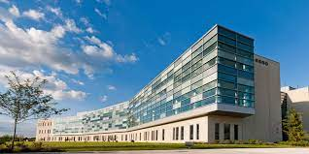
2022 Summer Butler-FNL/ATOM Project Presentation
July 27, 2022
DEPARTMENT OF HEALTH AND HUMAN SERVICES • National Institutes of Health • National Cancer Institute
Frederick National Laboratory is a Federally Funded Research and Development Center operated by Leidos Biomedical Research, Inc., for the National Cancer Institute

Slide 2
Agenda
Overview of the Butler-FNL/ATOM Project, Naomi Ohashi, FNL
Opening remarks, Dr. Ethan Dmitrovsky, President, FNL
Student Presentation and Q&A
Artificial Intelligence-based Drug Discovery for Cytochrome P450
Closing remarks, Dr. Ryan Weil, Director, FNL

Slide 3
2022 Summer Butler-FNL Project Presentation
Titli Sarkar, Naomi Ohashi | FNLCR
July 27, 2022
DEPARTMENT OF HEALTH AND HUMAN SERVICES • National Institutes of Health • National Cancer Institute
Frederick National Laboratory is a Federally Funded Research and Development Center operated by Leidos Biomedical Research, Inc., for the National Cancer Institute

Slide 4
Butler-FNL Project Highlights in Summer 2022
Worked on AI drug discovery projects
Demonstrated ATOM technology capabilities and applicability with beyond ATOM
Completed machine learning pipeline using AMPL for safety screen targets
Butler University’s College of Pharmacy & Health Sciences and FNL Partnership Development Office in conjunction with ATOM Consortium
3rd Summer Trainee Program with Butler University
12 week 2022 Summer Semester (May-July) (100% remote)
2 PharmD students hosted by FNLCR mentors

Slide 5
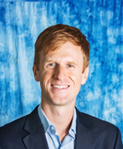
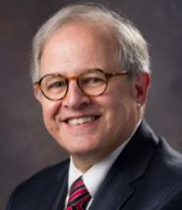
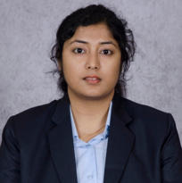
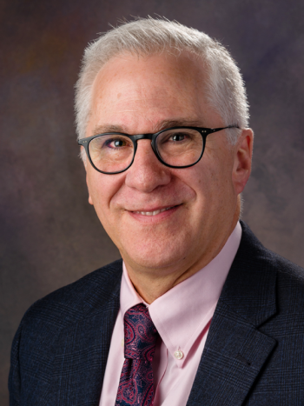

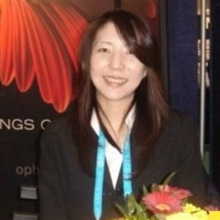
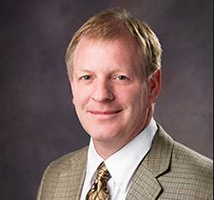



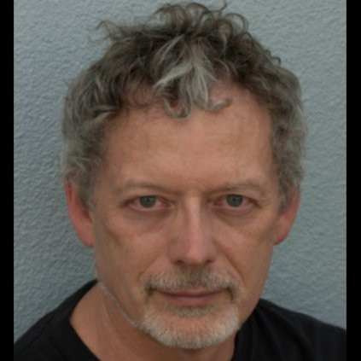

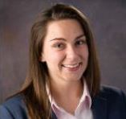
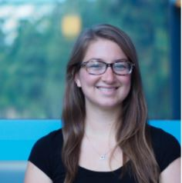
Supporters
Butler and FNL/ATOM Mentors
FNL Leadership
Caleb Class, Prof, Butler University
Dr. Ethan Dmitrovsky, FNL
Titli Sarkar, Project Mentor, FNL
Dr. Leonard Freedman, FNL
Sean Black, Project co-Mentor, FNL
Naomi Ohashi, PM, FNL
Dr. Eric Stahlberg, CRTP, FNL
Pinyi Lu, ATOM, FNL
Stewart He, ATOM, LLNL
Dr. Ryan Weil, CRTP, FNL
Kevin McLoughlin, ATOM, LLNL
Jonathan Allen, ATOM, LLNL
Dr. Maggie Scully, PDO, FNL
Amanda Paulson, ATOM, UCSF

Slide 6
Opening Remarks - Dr. Ethan Dmitrovsky
July 27, 2022
DEPARTMENT OF HEALTH AND HUMAN SERVICES • National Institutes of Health • National Cancer Institute
Frederick National Laboratory is a Federally Funded Research and Development Center operated by Leidos Biomedical Research, Inc., for the National Cancer Institute

Slide 7
Student Presentation and Q&A
July 27, 2022
DEPARTMENT OF HEALTH AND HUMAN SERVICES • National Institutes of Health • National Cancer Institute
Frederick National Laboratory is a Federally Funded Research and Development Center operated by Leidos Biomedical Research, Inc., for the National Cancer Institute

Slide 8
Predicting pIC50 for Cytochrome P450 Inhibitors using Advanced Machine Learning Platform for Drug Discovery: ATOM Modeling PipeLine (AMPL)
Butler University Summer Trainee Program 2022
FNL-Butler University Partnership Program
Trainees:
Madison Fanta, PharmD Candidate
Avery VonDielingen, PharmD Candidate
FNL Mentors:
Titli Sarkar, Ph.D, ATOM Data Scientist
Sean Black, BS, ATOM Data Scientist

Slide 9
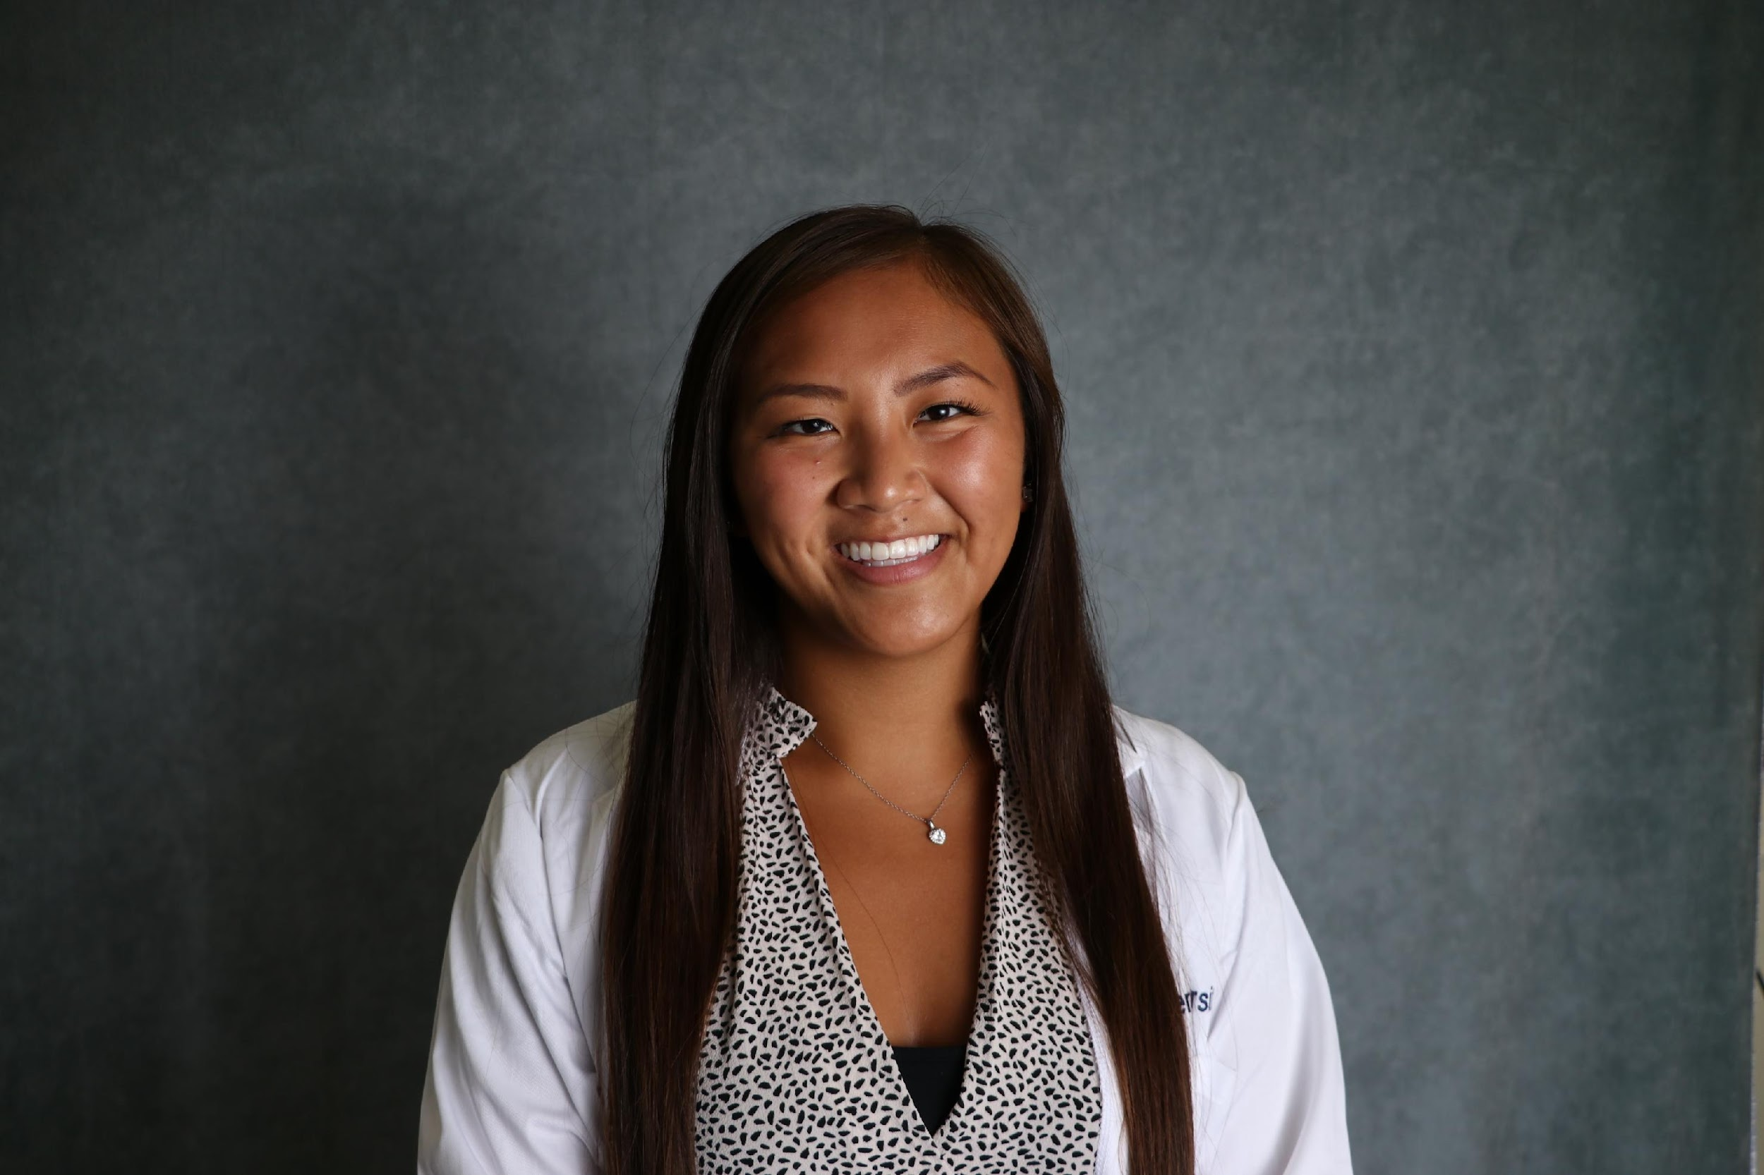
Name: Madison Fanta
ATOM Summer Trainee 2022
My Experience
Prior to this experience, the courses that correlate best with Machine Learning were Excel, Information Technology, and Bioinformatics.
Education
Doctor of Pharmacy (PharmD), Butler University (in progress)
Minors: Chemistry and Healthcare Management
About Me
I grew up in northwest Indiana (The Region).
In my free time, I enjoy spending time with my friends and family, learning to cook, and traveling (My next trip is backpacking through Europe for 35 days next May).
mfanta@butler.edu

Slide 10
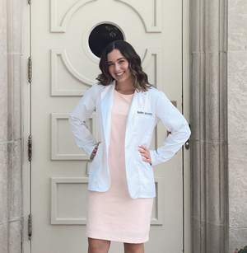
Name: Avery VonDielingen
ATOM Summer Trainee 2022
My Experience
Biotechnology course at Butler University which grew my interest for combining Pharmacy with Data Analytics
Education
PharmD Candidate at Butler University Class of 2025
Entrepreneurship concentration
About Me
Grew up in the Indianapolis, IN area (family has since moved to Wake Forest, NC)
In my free time I enjoy: golfing, walking trails, spending time with friends and family
avondiel@butler.edu

Slide 11
Keywords and Abbreviations
ATOM = Accelerating Therapeutics for Opportunities in Medicine
AMPL = ATOM Modeling PipeLine
QSAR = Quantitative Structure-Activity Relationship
MoDaC = Predictive Oncology Model & Data Clearinghouse
CYP = Cytochrome P450
DTC = Drug Target Commons
ECFP = Extended-Connectivity Fingerprints
ER = Endoplasmic Reticulum
HPO = Hyperparameter Optimization
ML = Machine Learning
NN = Neural Network
RF = Random Forest
GraphConv = Graph Convolution

Slide 12
Outline
Weeks 1-2: Python Bootcamp
Weeks 3-11: ML project with ATOM using AMPL
Project Objective and Overview
AMPL Overview
Literature Research
Data Sourcing and Curation
Split and Featurize Data
Model Training
HPO and Predict Using Model
Conclusion and Discussion
Seminar Summaries

Slide 13
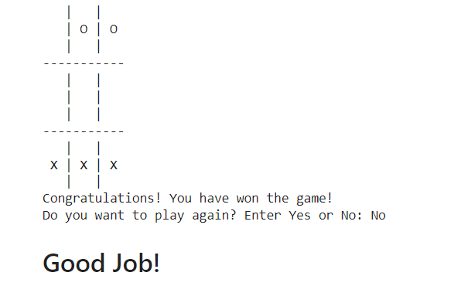
Learning Python
Completed Python Bootcamp on Udemy
Basic code definitions:
list, set, tuple, booleans
More complex coding:
statements, loops, methods, functions
Data visualization techniques:
matplotlib, pandas, seaborn
Student Orientation Presentation
ATOM Overview
Milestone Project:
Design a Tic-Tac-Toe Game
End Result:

Slide 14
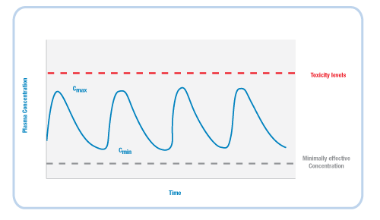

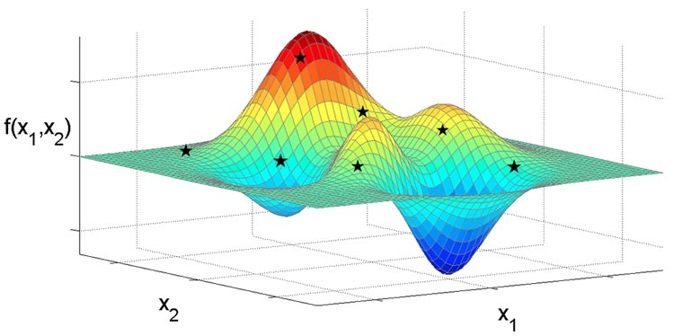


The ATOM Platform
Active Learning Drug Discovery Framework
AMPL
Machine Learning Pipeline
Efficacy
Multi-Parameter Optimization Loop
Property prediction models
Safety
Working
Compound
Library
PK
Design Criteria
Developability
Generative Molecular Design
proposes new molecules with optimized properties
Active learning
decides if/when a simulation or experiment is needed to improve or validate models
Retrain property prediction models
Molecular Feature
Simulations
Simulation
Human-relevant assays, complex in vitro models
Chemistry Design & Synthesis
Experiment
Notes:
The ATOM general workflow starts with a compound library where public data are collected, curated and saved as machine learning model ready data.
Next, machine learning models are created for predicting molecular properties using AMPL software pipeline.

Slide 15
Outline
Weeks 1-2: Python Bootcamp
Weeks 3-11: ML project with ATOM using AMPL
Project Objective and Overview
AMPL Overview
Literature Research
Data Sourcing and Curation
Split and Featurize Data
Model Training
HPO and Predict Using Model
Conclusion and Discussion
Seminar Summaries

Slide 16
Project Objective and Overview
Project Goals:
Build Machine Learning models to predict inhibition percentage of Safety Screen Targets.
Support the ATOM team with refined dataset (curated, ML-ready, + new inhibitors) for further development of Drug Discovery projects.
Targets: Predict pIC50 values on Cytochrome p450 inhibitors CYP3A4, CYP2D6, and CYP2C9.
Collect Data
-Databases
-Literature
Curate Data
-Python
-Google Colab
Build and Train Models
-Splitting
-Featurizing
-Hyperparameter Optimization
Analyze Model Metrics
Use Best Models for Inference

Slide 17
What are we trying to predict?
IC₅₀ = concentration of inhibitor required to reduce the enzymatic
activity to half of the uninhibited rate
IC₅₀ = μM (10⁻⁶)
pIC₅₀ = -log₁₀(IC₅₀)
μM = micromolar

Slide 18
Outline
Weeks 1-2: Python Bootcamp
Weeks 3-11: ML project with ATOM using AMPL
Project Objective and Overview
AMPL Overview
Literature Research
Data Sourcing and Curation
Split and Featurize Data
Model Training
HPO and Predict Using Model
Conclusion and Discussion
Seminar Summaries

Slide 19
AMPL: End-to-End Data-Driven Modeling Pipeline
Curated Smiles
COc1ccc2[nH]cc(CCNC(C)=O)c2c1
NC(=O)c1cnccn1
Clc1cccc(N2CCNCC2)c1
Nc1c2c(nc3ccccc13)CCCC2
CC(=O)Nc1ccc(O)cc1
CC(=O)Nc1nnc(S(N)(=O)=O)s1
CCCSc1ccc2nc(NC(=O)OC)[nH]c2c1
CC(C)(C)NCC(O)c1ccc(O)c(CO)c1
C=CCc1ccccc1OCC(O)CNC(C)C
CC(=O)Nc1c(I)c(NC(C)=O)c(I)c(C(=O)O)c1I
CCC1(c2ccc(N)cc2)CCC(=O)NC1=O
Train/Valid/Test Split:
Random
Scaffold
Fingerprint
Butina
Temporal
Ave_min
Featurize with Molecular Descriptors:
Moe
Mordred
RDKit
ECFP
Graphconv
Model:
Random Forest
Neural Network
XGboost
Type:
Classification
Regression
Predict:
Use to predict on Molecular Property
e.g., pIC50 value/ Ki value of novel molecules

Slide 20
AMPL Usage: Github Tutorials https://github.com/ATOMScience-org/AMPL/tree/master/atomsci/ddm/examples/tutorials
Install AMPL (in Colab)
Data Curation using AMPL
Read data .csv files as Pandas Dataframe format
Generate a standardized SMILES, InChI keys for dataset with curation and structure modules.
# RDkit modules are used to process the SMILES strings
Visualize molecules using Rdkit
Train & Store models
• Random Forest
• Neural Network
• XGBoost
Compare Models (HPO) using AMPL
Evaluate models on unexposed targets using predict_from_model_file function
Prediction
Learn to store & read models
Use to predict on novel molecules
Slide courtesy to Dr. Joseph Ivanic

Slide 21
Outline
Weeks 1-2: Python Bootcamp
Weeks 3-11: ML project with ATOM using AMPL
Project Objective and Overview
AMPL Overview
Literature Research
Data Sourcing and Curation
Split and Featurize Data
Model Training
HPO and Predict Using Model
Conclusion and Discussion
Seminar Summaries

Slide 22
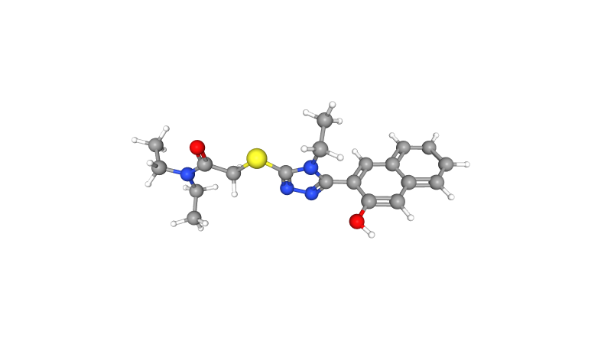
Literature Review: Cytochrome P450 Enzymes
Drug metabolism
Membrane bound enzymes primarily expressed in the liver
Causes about 50% of all drugs to be eliminated
57 known isoforms
Our focus is on CYP3A4, CYP2D6, and CYP2C9
Compound: N,N-Diethyl-2-[4-ethyl-5-(3-hydroxy-naphthalen-2-yl)-4H-[1,2,4]triazol-3-ylsulfanyl]-
acetamide
(MoDaC CYP2C9 Union Trainset)
Image Source: PubChem CID 645573

Slide 23
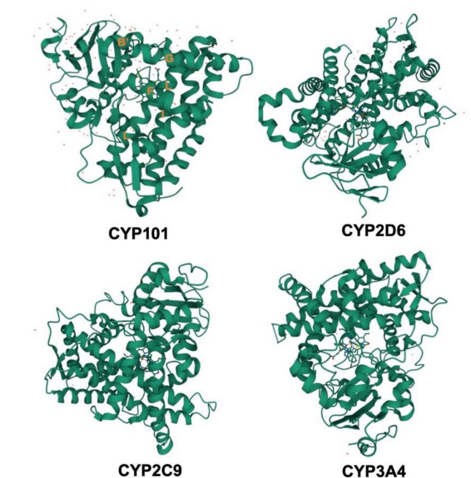
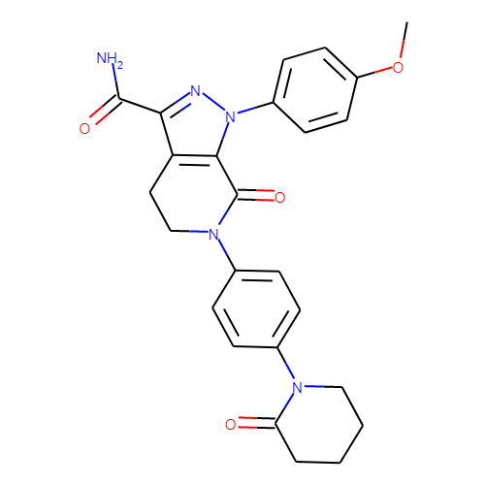
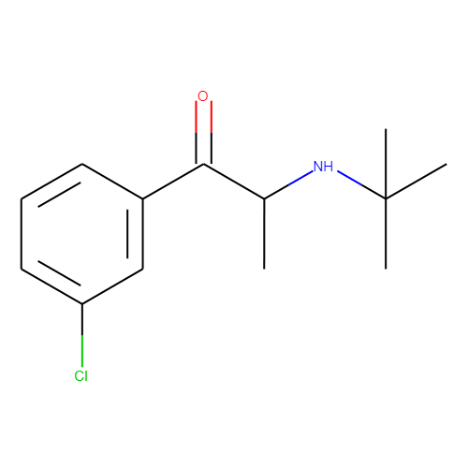
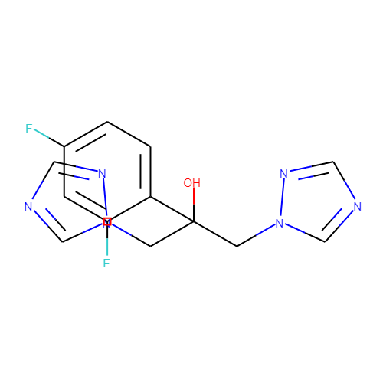
Literature Review: Compare CYPs
Eliquis
Bupropion
Fluconazole
CYP3A4
Location: liver and small intestine
15-20% of CYP proteins
Metabolizes 50% of all drugs
Binds to a diverse set of substrate structures
CYP2D6
Location: liver
2% of CYP proteins
Metabolizes 20% of drugs that undergo biotransformation
Prefers basic substrates
CYP2C9
Location: liver
18% of CYP proteins
Metabolizes 25% of drugs
Prefers slightly acidic substrates
Sources: Shao Z et.al., Chapter 14 - Pharmacogenomics, Elsevier, Volume 7, Pages 321-353, 2020. DOI: 10.1016/B978-0-444-64066-6.00014-9
Raj Vuppalanchi, Practical Hepatic Pathology: A Diagnostic Approach, Elsevier, Pages 45-52, 2011. DOI: 10.1016/B978-0-443-06803-4.00004-6
Rommel Tirona & Richard Kim, Clinical and Translational Science (Second Edition), Academic Press, Pages 364-388, 2017. DOI: 10.1016/B978-0-12-802101-9.00020-X
Zhao, M et al. Cytochrome P450 Enzymes and Drug Metabolism in Humans. Int. J. Mol. Sci. 2021, 22, 12808. DOI: 10.3390/ijms222312808
Images: CHEMBL231779, CHEMBL894, CHEMBL106

Slide 24
Literature Review: Search Novel CYP Inhibitors
Results
Novel Compounds
Gartanin, Cepharanthine (CEP), and ZY12201
Potential CYP Connection:
Gartanin: inhibitor of CYP2C9 and CYP2D6 by 31% and 52% respectively
CEP: inhibitor of CYP3A4, CYP2E1, and CYP2C9 were inhibited by CEP in vitro
ZY12201: pan CYP inhibitor (1A2, 2B6, 2C8, 2C9, 2C19, 2D6, 2E1, and 3A4/5)
Checked against:
MoDaC CYP3A4, CYP2D6, and CYP2C9
Union Train, Union Test, DTC, ExCAPE, and ChEMBL compounds
Novel 15 + Tecovirimat 1
No intersection was found! (canonical SMILES)
Sources: Jia Tao & Hao Ai Metabolism of gartanin in liver microsomes and its modulating effects on cytochrome P450s, Xenobiotica, 52:4, Pages 335-345, 2022. DOI:10.1080/00498254.2022.2076631
Zhang X et.al., In vitro inhibitory effects of cepharanthine on human liver cytochrome P450 enzymes, Pharmaceutical Biology, Pages 247-252, Mar 2020. DOI: 10.1080/13880209.2020.1741650
Giri P et.al., ZY12201: A Potent TGR5 Agonist: Identification of a Novel Pan CYP450 Inhibitor Tool Compound for In-Vitro Assessment, Drug Metab Lett, Pages 1-17, Jan 2022.
DOI: 10.2174/1872312815666220315145945
Notes:
Gartanin is a compound found in mangosteen, a popular tropical fruit, that has various pharmacological activities including anticancer, anti-inflammation, and antioxidation
CEP is extracted from the roots of Stephania cepharantha Hayata (Menispermaceae) and has a range of therapeutic potential including known antitumor activity, antitumor invasion and pro-apoptotic action in many cancer cells.

Slide 25
Outline
Weeks 1-2: Python Bootcamp
Weeks 3-11: ML project with ATOM using AMPL
Project Objective and Overview
AMPL Overview
Literature Research
Data Sourcing and Curation
Split and Featurize Data
Model Training
HPO and Predict Using Model
Conclusion and Discussion
Seminar Summaries

Slide 26
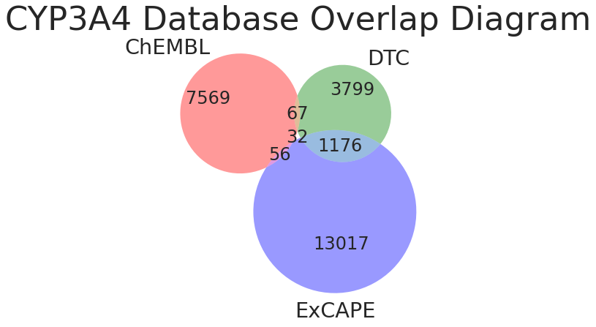
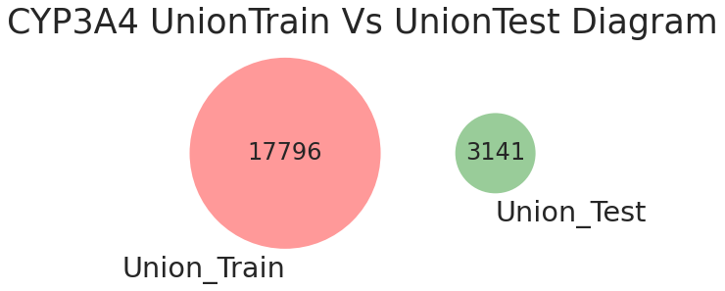
Data Sourcing from MoDaC
Asset Name: Safety Screen Targets
Targets: CYP3A4, CYP2D6, CYP2C9
Data - Raw data - from DTC, ChEMBL, and ExCAPE databases +
ML-ready curated data - union train/test set (merged data from all sources)
Model - Contains pre-trained best models using AMPL 1.1.0
https://modac.cancer.gov/

Slide 27
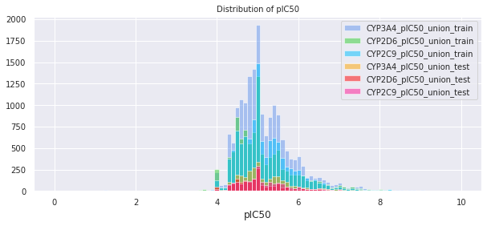
Distribution of pIC50 on Raw Data
Number of Compounds

Slide 28
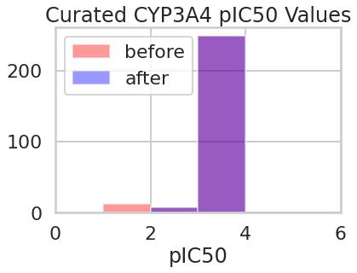
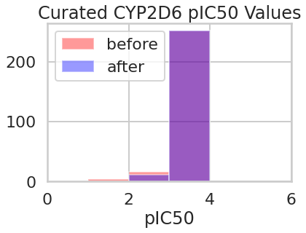
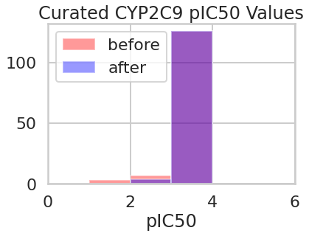
Summarized Data After Data Curation
Standardized SMILES strings
Average and remove duplicates
Number of Compounds
Number of Compounds
Number of Compounds
12 Removed Compounds
9 Removed Compounds
6 Removed Compounds

Slide 29
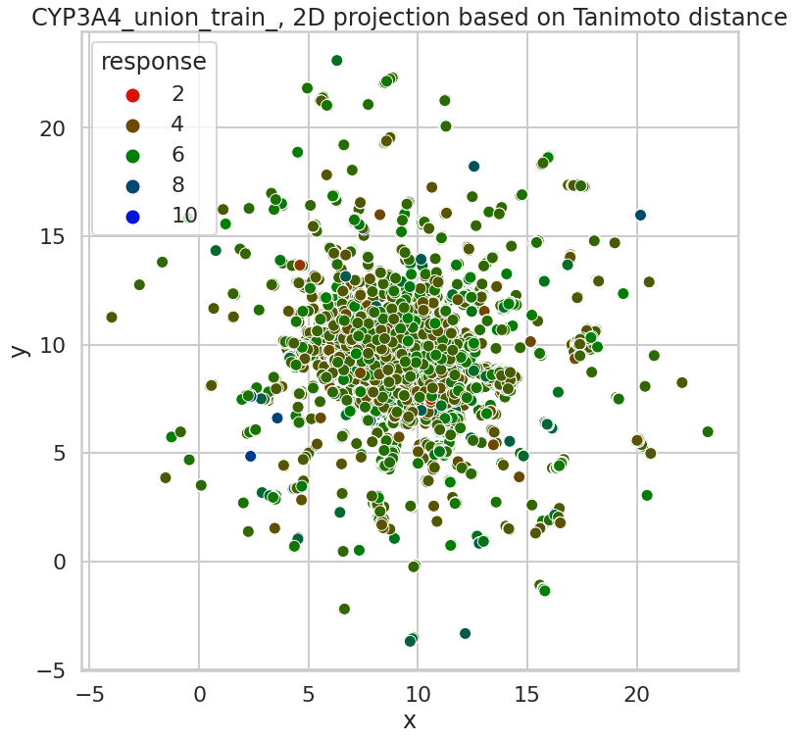
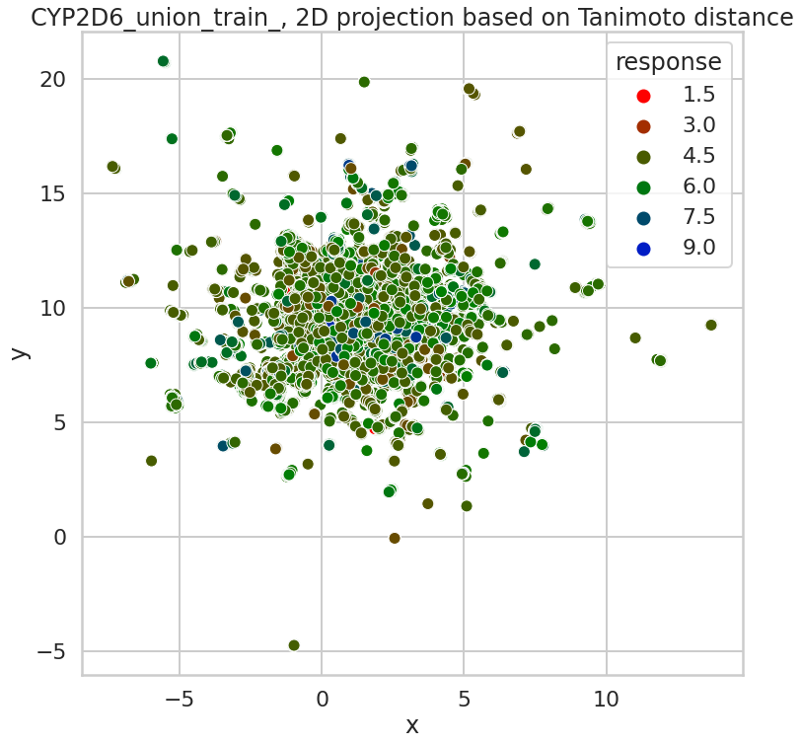
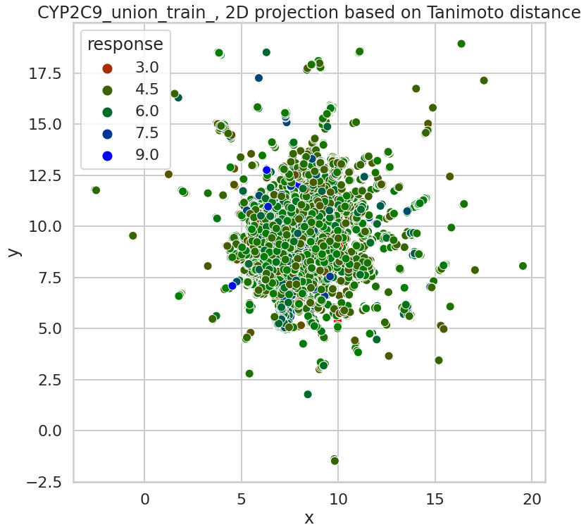
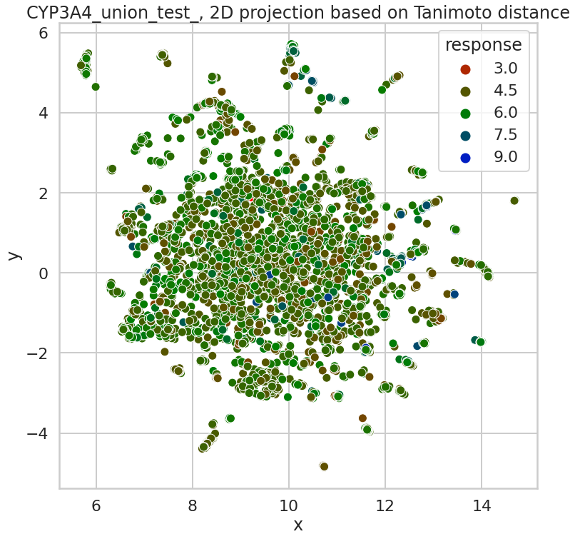
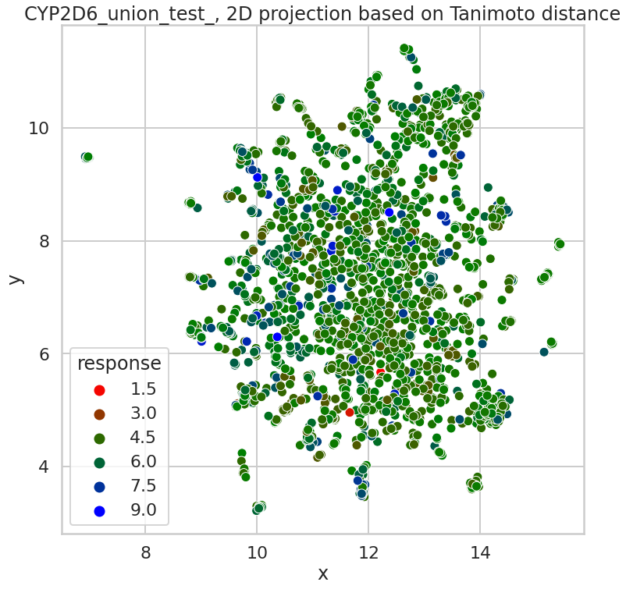
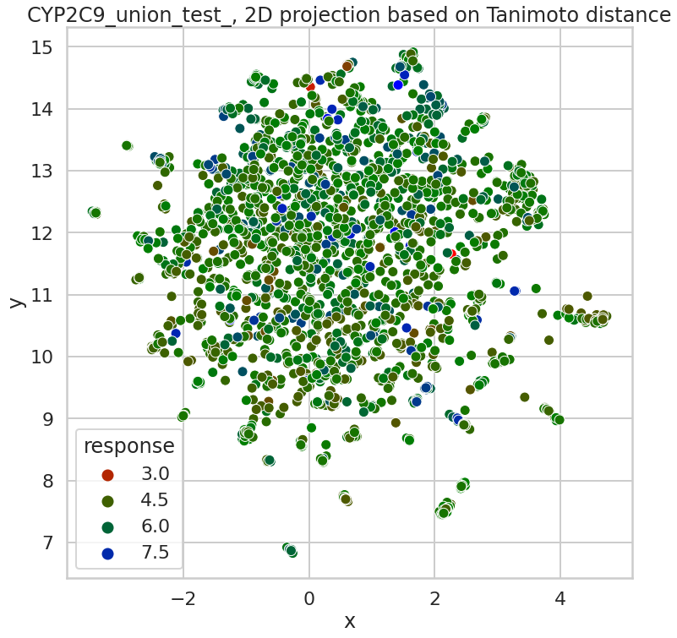
Diversity Plots of Response Column - pIC50
CYP3A4
CYP2D6
CYP2C9
Union_Train
Union_Test
Courtesy to Titli Sarkar

Slide 30
Outline
Weeks 1-2: Python Bootcamp
Weeks 3-11: ML project with ATOM using AMPL
Project Objective and Overview
AMPL Overview
Literature Research
Data Sourcing and Curation
Split and Featurize Data
Model Training
HPO and Predict Using Model
Conclusion and Discussion
Seminar Summaries

Slide 31
Data Splitting (Scaffold Split)
MoDaC Safety Screen Targets Asset
(Raw Data from DTC, ChEMBL, ExCAPE)
Pre-curated, Merged, and
Supplied Beforehand
Union Testset
(External Dataset)
Union Trainset
(Scaffold split)
Train(~70%)
Valid(~15%)
Test
(Minimal # of Samples)
(~15%)
Splitter = Scaffold | Featurizer = ECFP/Graphconv

Slide 32
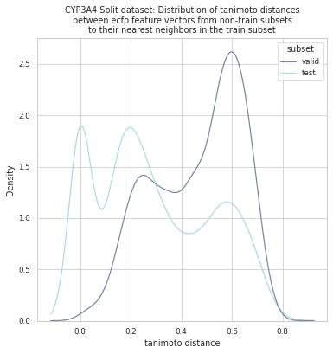
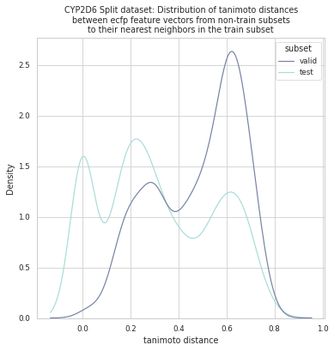
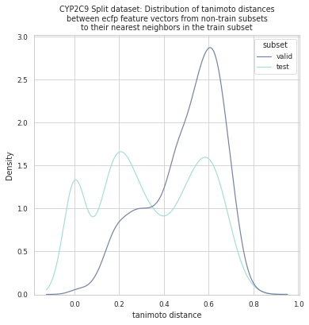
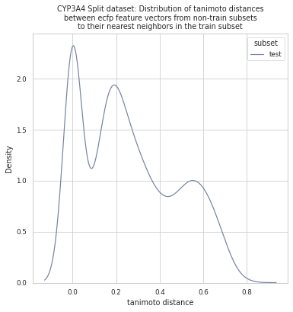
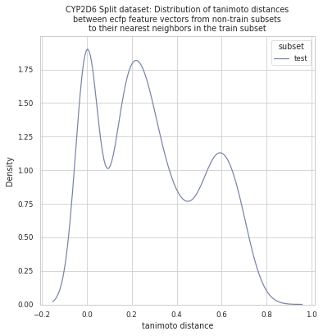
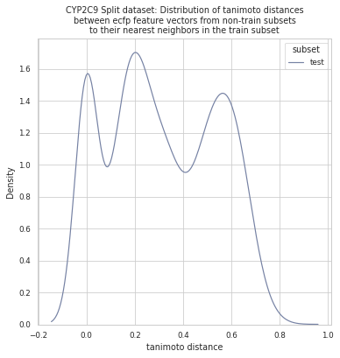
Tanimoto Distance Plot: Train to Test/Valid
CYP3A4
Union/Split
-train 15112
-test 3157
-valid 2668
CYP2D6
Union/Split
-train 8868
-test 1855
-valid 1565
CYP2C9
Union/Split
-train 9615
-test 2007
-valid 1697
CYP3A4
Union
-train 17796
-test 3141
CYP2D6
Union
-train 10445
-test 1843
CYP2C9
Union
-train 11321
-test 1998
Courtesy to Titli Sarkar

Slide 33
Outline
Weeks 1-2: Python Bootcamp
Weeks 3-11: ML project with ATOM using AMPL
Project Objective and Overview
AMPL Overview
Literature Research
Data Sourcing and Curation
Split and Featurize Data
Model Training
HPO and Predict Using Model
Conclusion and Discussion
Seminar Summaries

Slide 34
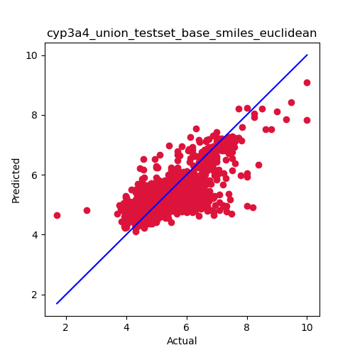
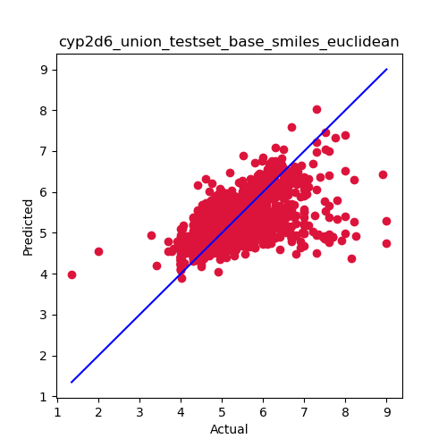
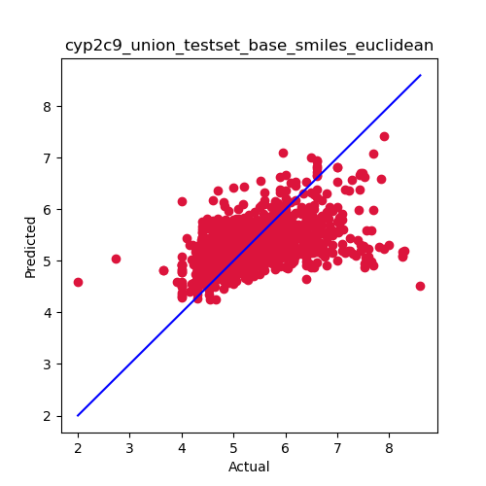
Baseline Models
Retrain MoDaC Models + prediction on Union Testset (using AMPL 1.4.1)
model | Dist Metric | Union train r2_score | Union test r2_score
CYP3A4 | Euclidean | 0.61 | 0.51
CYP2D6 | Euclidean | 0.65 | 0.35
CYP2C9 | Euclidean | 0.40 | 0.30
Purpose – predict using old models
Use split file from pretrained models on MoDaC (AMPL 1.1.0)
Use best models uploaded in MoDaC (AMPL 1.1.0)
Use model parameters from MoDaC models (AMPL 1.1.0)
No data curation
R2_score = 0.51
R2_score = 0.35
R2_score = 0.30
Courtesy to Titli Sarkar

Slide 35
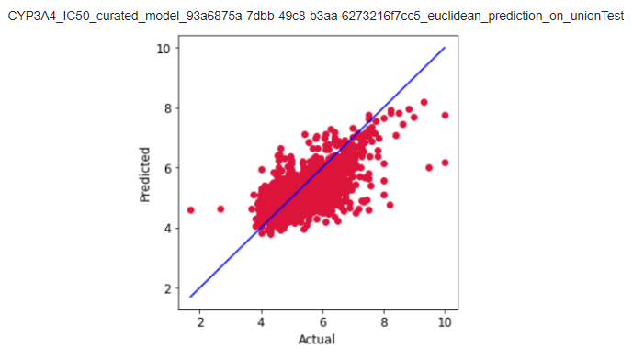
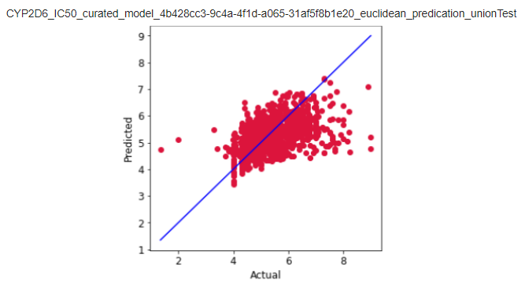
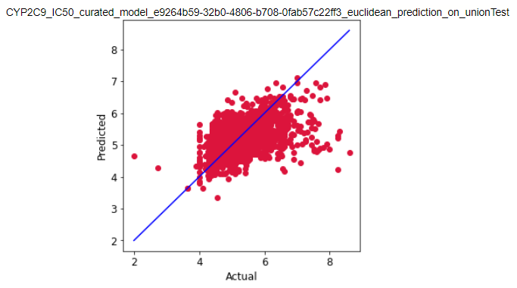
Train
CYP Model Performance on Best MoDaC Model Parameters (Prediction Using AMPL 1.4.1)
Model_Type: Neural Net
Featurizer: GraphConv
Prediction on Union_Test
model | Train r2_score | Valid r2_score | Union test r2_score
CYP3A4 | 0.58 | 0.19 | 0.43
CYP2D6 | 0.51 | 0.13 | 0.26
CYP2C9 | 0.48 | 0.08 | 0.21
Union_test_r2_score = 0.43
Union_test_r2_score = 0.26
Union_test_r2_score = 0.21
Notes:
CYP Results on Pretrained Model Parameters from MoDaC (Prediction Using AMPL 1.4.1)

Slide 36
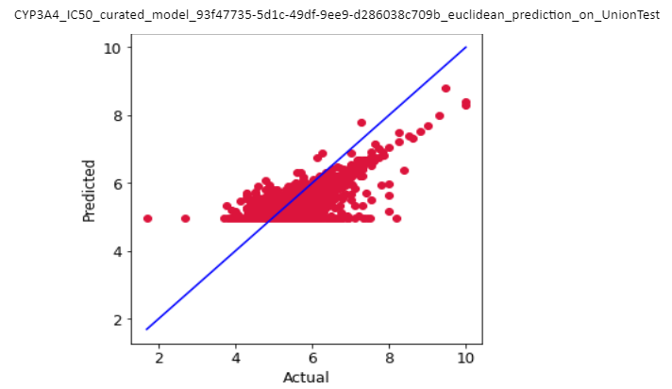
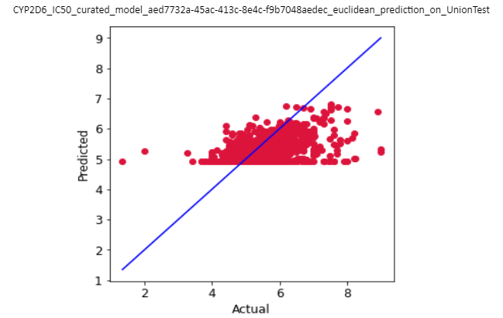
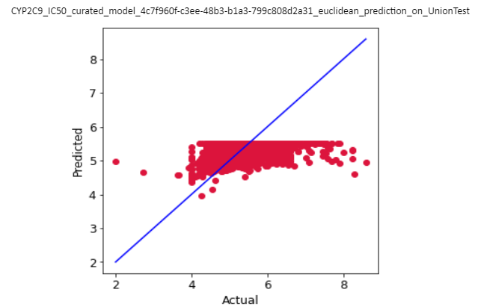
Train
CYP Model Performance on Edited QSAR Paper Parameters (Prediction Using AMPL 1.4.1)
model | Train r2_score | Valid r2_score | Union test r2_score
CYP3A4 | 0.67 | 0.25 | 0.50
CYP2D6 | 0.63 | 0.15 | 0.32
CYP2C9 | 0.50 | 0.13 | 0.24
Model_Type: Neural Net
Featurizer: ECFP
Prediction on Union_Test
Union_test_r2_score = 0.50
Union_test_r2_score = 0.32
Union_test_r2_score = 0.24
Kwon et al. BMC Bioinformatics (2019) 20:521 https://doi.org/10.1186/s12859-019-3135-4
Performance > 80% (predicting bioactivity)

Slide 37
Outline
Weeks 1-2: Python Bootcamp
Weeks 3-11: ML project with ATOM using AMPL
Project Objective and Overview
AMPL Overview
Literature Research
Data Sourcing and Curation
Split and Featurize Data
Model Training
HPO and Predict Using Model
Conclusion and Discussion
Seminar Summaries

Slide 38
HPO Parameters
Grid Search, Random Search, and Bayesian Search
Scaffold Split
ECFP Featurizer
Random Forest
Neural Networks
Number of estimators: [10,15,20,
25,50,100,200,400,
800]
Max Depth: [5,10,15, 20,100]
Max Features: [20,24,
28,32]
Learning Rate: [0.0001,
0.0005,
0.001,
0.005,0.01,0.025,0.05]
Layer Sizes:
[16, 32, 64, 128, 256]
Dropouts: [0.3,0.4,0.5,0.6]
Number of Layers: [2,3,4]

Slide 39
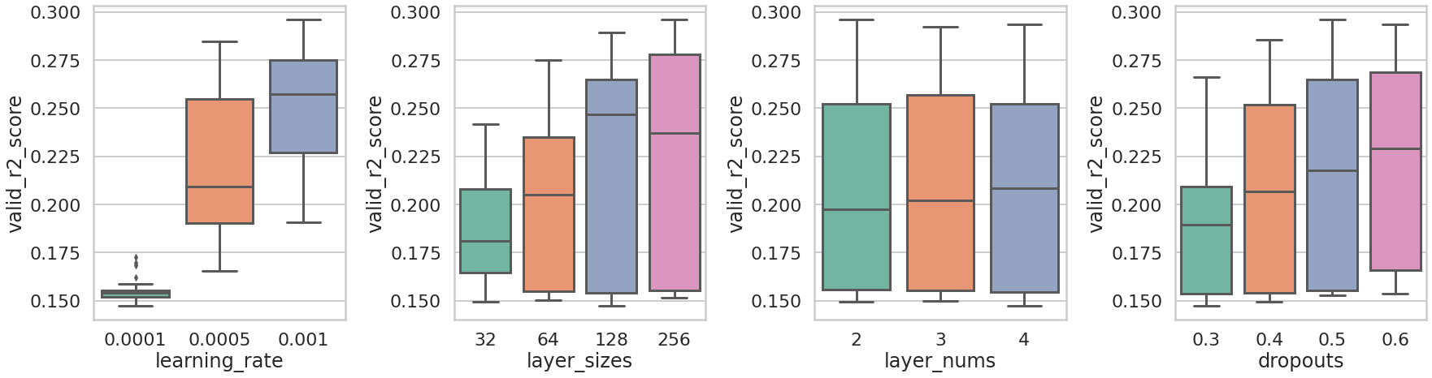
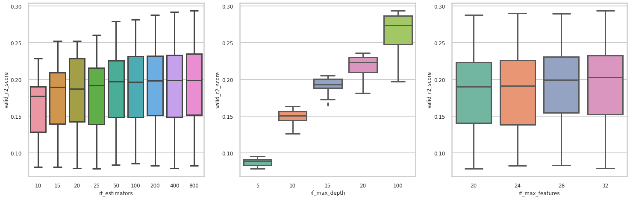
Best HPO Parameters for CYP3A4 (based on valid r2_score)
Neural Network
Grid Search
learning_rate = 0.001
layer_sizes = 128
layer_nums = 4
dropouts = 0.6
Random Forest
Grid Search
rf_estimators = 800
rf_max_depth = 100
rf_max_features = 32

Slide 40
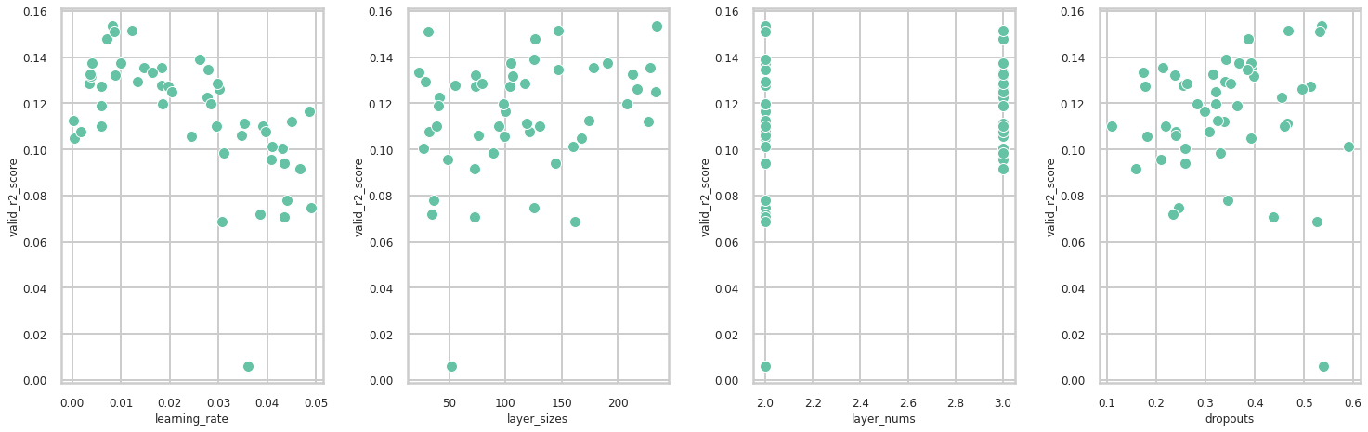

Best HPO Parameters for CYP2D6 (based on valid r2_score)
Neural Network
Random Search
learning_rate = 0.0082
layer_sizes = 235
layer_nums = 2
dropouts = 0.5363
Random Forest
Random Search
rf_estimators = 555
rf_max_depth = 65
rf_max_features = 26

Slide 41


Plot of Loss for all models for CYP2C9 (based on valid r2_score)
Neural Network
learning_rate = 0.0065
layer_sizes = 208
layer_nums = 2
dropouts = 0.5237
loss
Bayesian Search
Loss = 1 - r2_score
models
Random Forest
rf_estimators = 171
rf_max_depth = 48
rf_max_features = 30
loss
Notes:
Loss plot bayesian x - trials 50 , y - loss

Slide 42



HPO Results
R2_Score_valid
 | RF/ECFP | NN/ECFP
CYP3A4 | 0.29 | 0.30
CYP2D6 | 0.25 | 0.17
CYP2C9 | 0.20 | 0.19
R2_Score_test
 | RF/ECFP | NN/ECFP
CYP3A4 | 0.62 | 0.60
CYP2D6 | 0.42 | 0.40
CYP2C9 | 0.40 | 0.36
Best model
final scores

Slide 43
Predict Using Best Models
on Novel Compounds

Slide 44
Novel Compounds
Raw data from UCSF
Com pound | 3A4_ Midazolam _µM | 3A4_ Testosterone _µM | 2D6_ µM | 2C9_ µM | 2C19_ µM | 2C8_ µM | 2B6_ µM | 1A2_ µM
0 | > 10.0 | > 10 | > 10.0 | > 10.0 | > 10.0 | > 10.0 | > 10.0 | > 10.0
1 | 3.53 | 2.1 | 4.69 | > 10.0 | 8.75 | > 10.0 | 9.54 | > 10.0
2 | 1.45 | 4.5 | 0.94 | > 10.0 | > 10.0 | > 10.0 | > 10.0 | > 10.0
3 | 0 | 0 | 2.26 | > 10.0 | > 10.0 | > 10.0 | > 10.0 | > 10.0
4 | > 10.0 | > 10 | 11.2 | > 10.0 | > 10.0 | > 10.0 | > 10.0 | 20.3
5 | 4.84 | 17 | 22.4 | > 10.0 | > 10.0 | > 10.0 | > 10.0 | > 10.0
6 | > 10.0 | 17 | 12.5 | > 10.0 | > 10.0 | > 10.0 | > 10.0 | 2.08
7 | > 10.0 | > 10 | 10.9 | > 10.0 | > 10.0 | > 10.0 | > 10.0 | > 10.0
8 | > 10.0 | > 10 | 10.3 | > 10.0 | 22.6 | > 10.0 | > 10.0 | > 10.0
9 | 15.6 | > 10 | 15.8 | > 10.0 | > 10.0 | > 10.0 | > 10.0 | > 10.0
10 | > 10.0 | 12 | > 10.0 | 1.36 | 14.1 | > 10.0 | > 10.0 | > 10.0
11 | 4.15 | 2.4 | 1.51 | 5.34 | 7.72 | 8.63 | 3.67 | > 10.0
12 | 15.7 | 11 | 1.32 | > 10.0 | 10.9 | 12.5 | 11.3 | > 10.0
13 | > 10.0 | 43 | 3.29 | > 10.0 | 0.4 | > 10.0 | 0.57 | > 10.0
14 | > 10.0 | 20 | 11.7 | 7.34 | 17.7 | 10.9 | 8.58 | > 10.0
µM column -> [‘relation’, ‘value’]
µM -> pIC50
Reverse relation sign
An example of µM -> pIC50 conversion
Com pound | 2D6 _µM | 2D6_µM _relation | 2D6_µM _value | 2D6_pIC50 _relation | 2D6_pIC50 _value
0 | > 10.0 | > | 10.00 | < | 6.00
1 | 4.69 | = | 4.69 | = | 6.33
2 | 0.94 | = | 0.94 | = | 7.03
3 | 2.26 | = | 2.26 | = | 6.65

Slide 45


Determine Best Class for Novel Compounds
Best class = max of pIC50
Com pound | 3A4_midazolam _pIC50 | 2D6 _pIC50 | 2C9 _pIC50 | Max _pIC50 | Max_ Index
0 | 6.0 | 6.0 | 6.0 | 6.0 | CYP3A4
1 | 6.5 | 6.3 | 6.0 | 6.5 | CYP3A4
2 | 6.8 | 7.0 | 6.0 | 7.0 | CYP2D6
3 | 0.0 | 6.6 | 6.0 | 6.6 | CYP2D6
4 | 6.0 | 6.0 | 6.0 | 6.0 | CYP3A4
5 | 6.3 | 5.6 | 6.0 | 6.3 | CYP3A4
6 | 6.0 | 5.9 | 6.0 | 6.0 | CYP3A4
7 | 6.0 | 6.0 | 6.0 | 6.0 | CYP3A4
8 | 6.0 | 6.0 | 6.0 | 6.0 | CYP3A4
9 | 5.8 | 5.8 | 6.0 | 6.0 | CYP2C9
10 | 6.0 | 6.0 | 6.9 | 6.9 | CYP2C9
11 | 6.4 | 6.8 | 6.3 | 6.8 | CYP2D6
12 | 5.8 | 6.9 | 6.0 | 6.9 | CYP2D6
13 | 6.0 | 6.5 | 6.0 | 6.5 | CYP2D6
14 | 6.0 | 5.9 | 6.1 | 6.1 | CYP2C9

Slide 46

Prediction on Novel Compounds using HPO Best Models
compound | actual_bestclass | predicted_valid | predicted_test
1 | CYP3A4 | CYP2D6 | CYP2D6
2 | CYP3A4 | CYP2D6 | CYP3A4
3 | CYP2D6 | CYP2D6 | CYP2D6
4 | CYP2D6 | CYP2D6 | CYP2D6
5 | CYP3A4 | CYP2D6 | CYP2D6
6 | CYP3A4 | CYP3A4 | CYP3A4
7 | CYP3A4 | CYP2D6 | CYP2D6
8 | CYP3A4 | CYP2C9 | CYP2C9
9 | CYP3A4 | CYP2D6 | CYP2C9
10 | CYP2C9 | CYP2D6 | CYP2C9
11 | CYP2C9 | CYP2D6 | CYP2C9
12 | CYP2D6 | CYP2D6 | CYP2C9
13 | CYP2D6 | CYP2D6 | CYP2C9
14 | CYP2D6 | CYP2D6 | CYP2D6
15 | CYP2C9 | CYP2C9 | CYP2C9

Slide 47


Prediction on Novel Compounds using HPO Best Models (test)
Accuracy = 0.53

Slide 48
Outline
Weeks 1-2: Python Bootcamp
Weeks 3-11: ML project with ATOM using AMPL
Project Objective and Overview
AMPL Overview
Literature Research
Data Sourcing and Curation
Split and Featurize Data
Model Training
HPO and Predict Using Model
Conclusion and Discussion
Seminar Summaries

Slide 49
Conclusion and Discussion
Conclusion:
HPO increased our test and valid r2 scores
RF/ECFP generally gave us the highest r2 scores
Additional testing and training is needed
Future Considerations:
Different Splitters and Model Types
HPO with GraphConv, MOE, and Mordred featurizers
Further examination of novel CYP inhibitors

Slide 50
Outline
Weeks 1-2: Python Bootcamp
Weeks 3-11: ML project with ATOM using AMPL
Project Objective and Overview
AMPL Overview
Literature Research
Data Sourcing and Curation
Split and Featurize Data
Model Training
HPO and Predict Using Model
Conclusion and Discussion
Seminar Summaries

Slide 51
Clinical Research Seminars
Clinical Research Management- What does it Entail?
Case Study of Ebola Virus Disease (EVD)
Randomized Controlled Trials
Clinical Trials 101- What you need to know
Outlined Phases 0-4 of Clinical Trials
Risks and Benefits of participation
Project Management 101- Introduction to Project Management Fundamentals for Clinical Research Professionals
Key characteristics of a project and project management
Launching & Managing a Clinical Research Study: Part 1 and 2
Defined a protocol and essentials of a protocol
Regulatory considerations with investigational new drugs
Safety and Good Clinical Practice

Slide 52
Ad-hoc Seminars
Dr. Joseph Ivanic, Ph.D.
Molecules, Generative Molecular Design, and Quantum Chemistry
Dr. Pinyi Lu, Ph.D.
Computer-Aided Drug Discovery (CADD)
Compared structure-based vs ligand-based modeling
Dr. Stewart He, Ph.D.
Compared ChemBERTa with MOE features on the task of predicting MM/GBSA values
Dr. Susan D. Mertins, Ph.D.
Dynamic Cellular Reaction Network Modeling of MAPK pathway
Ordinary Differential Equations (ODEs)
Dr. Hiranmayi Ranganathan, Ph.D.
Machine Learning Introduction
Dr. Amanda Paulson, Ph.D.
Expanded on the GMD Loop and QSAR Visualizations

Slide 53
Acknowledgements
Caleb Class, Ph.D. | Bioinformatician at Butler University
Eric Stahlberg, Ph.D. | Director, Cancer Data Science Initiatives
Maggie Scully, Ph.D. | Partnership Development Manager, FNL
M. Ryan Weil, Ph.D. | Director, Cancer Data Science Initiatives (CDSI)
Naomi Ohashi, MPA, PMP | ATOM Project Manager, ATOM/FNL
Sean Black, BS | ATOM Data Scientist
Titli Sarkar, Ph.D | ATOM Data Scientist
All the seminar series presenters.

Slide 54
References
Giri P et.al., ZY12201: A Potent TGR5 Agonist: Identification of a Novel Pan CYP450 Inhibitor Tool Compound for In-Vitro Assessment, Drug
Metab Lett, Pages 1-17, Jan 2022. DOI: 10.2174/1872312815666220315145945
Jia Tao & Hao Ai., Metabolism of gartanin in liver microsomes and its modulating effects on cytochrome P450s, Xenobiotica, 52:4, Pages
335-345, 2022. DOI:10.1080/00498254.2022.2076631
Kwon, S., Bae, H., Jo, J. et al., Comprehensive ensemble in QSAR prediction for drug discovery. BMC Bioinformatics, 521, 2019. DOI:
10.1186/s12859-019-3135-4
Minnich, A., McLoughlin, K., Tse, M., et al., AMPL: A data-driven modeling pipeline for Drug Discovery. Journal of Chemical Information and
Modeling, 60:4, Pages 1955–1968, 2020. DOI:10.1021/acs.jcim.9b01053
National Cancer Institute Predictive Oncology Model & Data Clearinghouse. Accessed July 18, 2022. https://modac.cancer.gov/
Raj Vuppalanchi, Practical Hepatic Pathology: A Diagnostic Approach, Elsevier, Pages 45-52, 2011. DOI: 10.1016/B978-0-443-06803-4.00004-6
Rommel Tirona & Richard Kim, Clinical and Translational Science (Second Edition), Academic Press, Pages 364-388, 2017. DOI:
10.1016/B978-0-12-802101-9.00020-X
Shao Z et.al., Chapter 14 - Pharmacogenomics, Elsevier, Volume 7, Pages 321-353, 2020. DOI: 10.1016/B978-0-444-64066-6.00014-9
Zhang X et.al., In vitro inhibitory effects of cepharanthine on human liver cytochrome P450 enzymes, Pharmaceutical Biology, Pages 247-252,
Mar 2020. DOI: 10.1080/13880209.2020.1741650
Zhao, M et al., Cytochrome P450 Enzymes and Drug Metabolism in Humans. Int. J. Mol. Sci. 2021, 22, 12808. DOI: 10.3390/ijms222312808
Image Sources: PubChem CID 645573, CHEMBL231779, CHEMBL894, CHEMBL106

Slide 55
Closing Remarks - Dr. Ryan Weil
July 27, 2022
DEPARTMENT OF HEALTH AND HUMAN SERVICES • National Institutes of Health • National Cancer Institute
Frederick National Laboratory is a Federally Funded Research and Development Center operated by Leidos Biomedical Research, Inc., for the National Cancer Institute

Slide 56
Thank you !
DEPARTMENT OF HEALTH AND HUMAN SERVICES • National Institutes of Health • National Cancer Institute
Frederick National Laboratory is a Federally Funded Research and Development Center operated by Leidos Biomedical Research, Inc., for the National Cancer Institute

